Slide 1
Introduction to Cloud Computing and AWS
Exploring EC2, S3 and IAM
Pranjal Srivastava

Slide 2

Pranjal Srivastava
Devops Engineer| Mentor | Polymath
8 years experience as Online Instructor
Taught more than 200,000 students/professionals Globally.
Worked at TCS
Passion to teach, Love to travel, Foodie
Skilled in Devops, Cloud, Machine learning and Data Science
https://www.linkedin.com/in/srivastavapranjal/
https://github.com/iampsrv

Slide 3
What is Cloud Computing?
Cloud computing is the on-demand delivery of IT resources over the Internet with pay-as-you-go pricing. Instead of buying, owning, and maintaining physical data centers and servers, you can access technology services, such as computing power, storage, and databases, on an as-needed basis from a cloud provider

Slide 4
Advantages of Cloud Computing
Cost Savings
Scalability
Elasticity
Security
Reliability and High Availability
Data Backup and Disaster Recovery
Rapid innovation
Increased efficiency
Deploy globally in minutes

Slide 5
What is AWS?
Amazon Web Services (AWS) is the world’s most comprehensive and widely adopted cloud platform
Offers over 200 fully featured services from data centers globally
Used by startups, enterprises, and governments to build, scale, and innovate faster

Slide 6
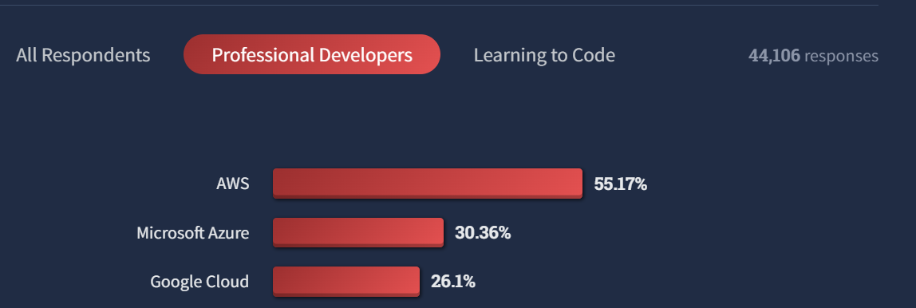
AWS vs Azure vs GCP

Slide 7
Key Benefits of AWS
Scalability – Instantly scale up/down based on demand
Cost-effective – Pay only for what you use
Global Reach – 100+ Availability Zones in 30+ Regions
Security – Built-in compliance and security best practices
Innovation – Access to cutting-edge tech (AI/ML, IoT, Big Data)

Slide 8
AWS Global Infrastructure
Regions – Geographic areas (e.g., US-East, EU-West)
Availability Zones (AZs) – Multiple isolated data centers within each region
Edge Locations – For low-latency content delivery (via CloudFront)

Slide 9
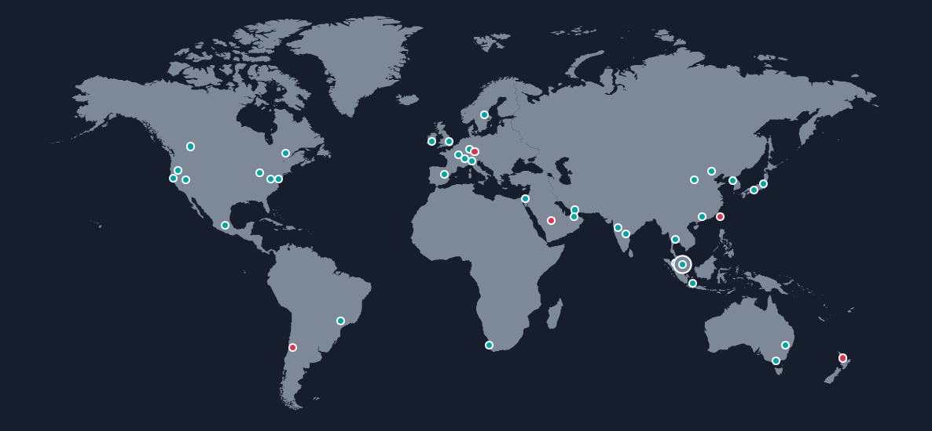
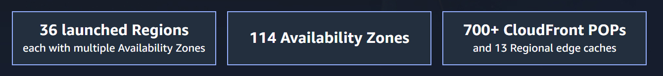

Slide 10

Data Centers, Availability Zones, Regions
Data Centers: Physical facilities housing servers and infrastructure for computing and storage.

Slide 11
Data Centers, Availability Zones, Regions
Availability Zones: One or more data centers grouped together within a region, designed for high availability and fault isolation.
us-east-1a

Slide 12
Data Centers, Availability Zones, Regions
Regions: Geographically separated areas containing multiple Availability Zones for fault tolerance and redundancy.
us-east-1a
us-east-1b
us-east-1c

Slide 13
Advantages of Global infrastructure
High Availability: Multiple Availability Zones in each Region ensure fault isolation and resilience against failures.
Low Latency: With Regions located around the world, users can deploy applications closer to end-users for faster response times.
Scalability: Globally distributed resources make it easy to scale applications up or down based on demand anywhere.
Disaster Recovery: Geographic distribution enables robust disaster recovery strategies across Regions.
Compliance and Data Residency: Regional presence helps meet data residency and compliance requirements specific to countries or industries.
Global Reach: Easily expand into new markets by deploying workloads in new AWS Regions without building new infrastructure.

Slide 14
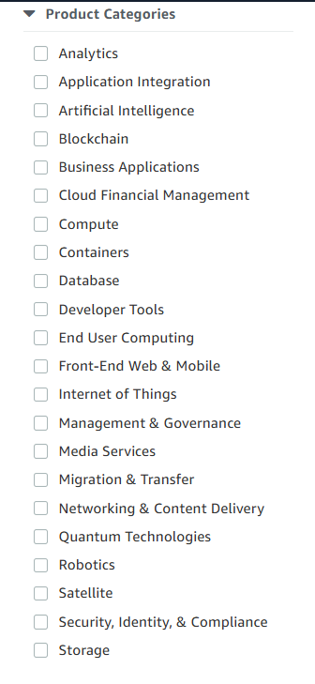
AWS Services categories

Slide 15
Popular AWS services

Slide 16
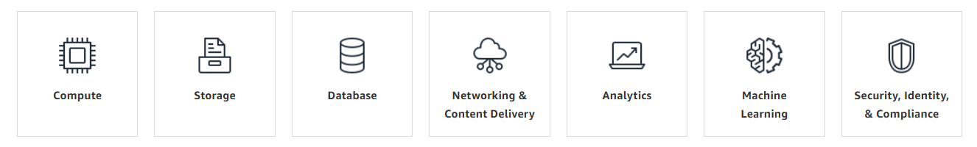
Virtual Private Cloud, Elastic Load Balancer, AWS Web Application Firewall, Cloudfront
SageMaker, Comprehend, Lex, Polly, Rekognition
S3, Elastic Block Storage, Elastic File System, Glacier
EC2,
Elastic Beanstalk,
Elastic Container Services,
Elastic Kubernetes Services,
Lambda,
Fargate
AWS RDS, DynamoDB, Neptune
Redshift, Quicksight, EMR, Glue, Athena, Kinesis
IAM, SSO, Cognito, KMS, Secret manager, WAF, Shield

Slide 17
IAM
Pranjal Srivastava

Slide 18
What is Auth?
Authentication
Identities
Auth
Authorization
Permissions

Slide 19
Overview of AWS IAM
IAM = Identity and Access Management
Enables secure control over AWS resources
Manage who can do what in your AWS environment

Slide 20
Key Features
Users, Groups, Roles, and Policies
Fine-grained permission control
Supports MFA (Multi-Factor Authentication)
Integrated with AWS Organizations and IAM Identity Center

Slide 21
IAM Core Components
Users – Represent people or applications
Groups – Collections of users for easier permission management
Roles – Temporary access with assumed identity (used for EC2, Lambda, cross-account access)
Policies – JSON-based documents defining permissions

Slide 22




Users, Groups, Roles, and Policies
IAM
Identities
Permissions
Users
Groups
Roles
Policy

Slide 23
Types of IAM Policies
Managed Policies – AWS-managed or customer-managed
Inline Policies – Embedded directly into a user, group, or role
Permission Boundaries – Limit the maximum permissions a role or user can have
Service Control Policies (SCPs) – Applied at the AWS Organizations level

Slide 24
IAM Best Practices
Use least privilege principle – Only give what’s necessary
Enable MFA on all root and IAM users
Use roles instead of access keys wherever possible
Regularly rotate credentials and review access
Use IAM Access Analyzer to validate and simulate policies

Slide 25
IAM Users
Represents a single person or application
Has long-term credentials (username/password or access keys)
Used for individual access to AWS services via CLI, SDK, or Console
Can be assigned permissions directly or through groups

Slide 26
IAM Group
A collection of IAM users
Used to simplify permissions management
Attach policies to groups instead of individual users
Example groups: Admins, Developers, Auditors

Slide 27
IAM Roles Use Cases
EC2 roles – Access to S3, DynamoDB, etc.
Cross-account access – Share resources securely
Federated identities – Use SAML or OIDC for single sign-on
AWS services – Lambda, ECS, CodeBuild assume roles to access resources

Slide 28
IAM Policy Syntax Basics
Written in JSON
Key elements:
"Effect": Allow or Deny
"Action": What you’re allowed to do
"Resource": What you’re allowed to do it to
"Condition": Optional filtering

Slide 29
IAM Access Analyzer
Identifies resources shared externally
Helps validate IAM policies
Useful for auditing and securing environments

Slide 30
Monitoring and Auditing
Use AWS CloudTrail to track IAM changes
Enable CloudWatch Logs for policy evaluations
Set up IAM credential reports for audits

Slide 31
EC2
Pranjal Srivastava

Slide 32
Overview of EC2
EC2 stands for Elastic Compute Cloud
Provides resizable compute capacity in the cloud
Ideal for running applications, websites, and workloads at scale
Pay-as-you-go pricing model

Slide 33
Key Features
Wide instance variety (general-purpose, compute-optimized, memory-optimized, etc.)
Auto Scaling to match demand
Elastic Load Balancing for high availability
Integrated with EBS (Elastic Block Store) for persistent storage

Slide 34
Instance Types
General Purpose (e.g., t4g, m7g) – Balanced CPU, memory, and networking
Compute Optimized (e.g., c7g) – Ideal for high-performance computing
Memory Optimized (e.g., r7g, x2idn) – For large in-memory databases
Storage Optimized (e.g., i4i) – High IOPS and throughput

Slide 35
Pricing Options
On-Demand – Pay for compute capacity by the hour or second
Reserved Instances – Up to 75% discount for 1 or 3-year commitment
Spot Instances – Save up to 90% on unused EC2 capacity
Savings Plans – Flexible pricing model with commitment

Slide 36
Security and Networking
Launch into Amazon VPC for network isolation
Control access with Security Groups and IAM roles
Use Key Pairs for SSH access to Linux/Windows instances
Supports encryption and compliance standards

Slide 37
EC2 vs Other AWS Compute Services
Feature | EC2 | Lambda | ECS/EKS
Control Level | Full control | No server mgmt | Container-level
Scalability | Manual/auto | Automatic | Automatic
Use Case | General workloads | Event-driven | Containers

Slide 38
EC2 Auto Scaling

Slide 39
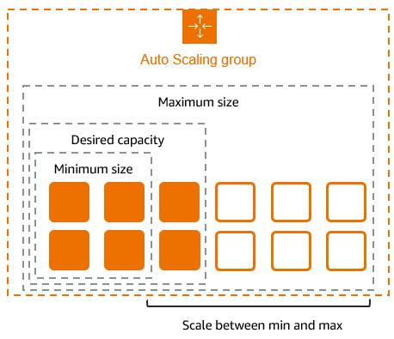

Slide 40
Elastic Load Balancer

Slide 41
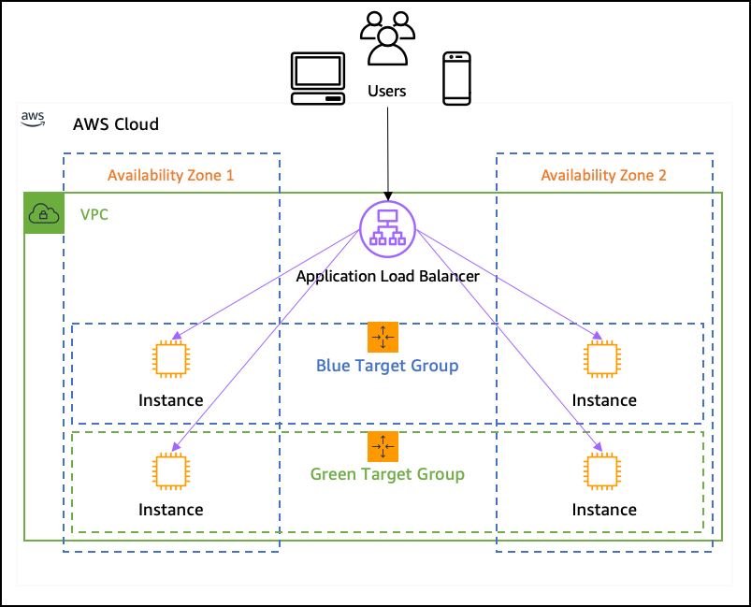

Slide 42
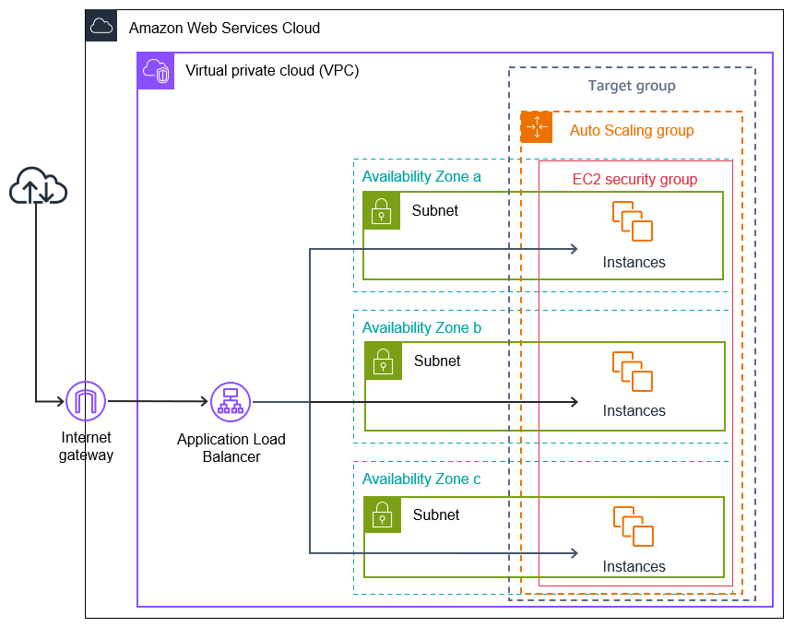

Slide 43
S3
Pranjal Srivastava

Slide 44
Overview of Amazon S3
S3 = Simple Storage Service
Scalable, secure, and durable object storage service
Stores data as objects in buckets
Ideal for backup, big data, websites, and app data

Slide 45
Key Features
99.999999999% (11 9s) durability
Unlimited storage, pay-as-you-go
Supports versioning, lifecycle policies, and replication
Integrated with AWS services like Lambda, CloudFront, Athena

Slide 46
Core Concepts
Object – File + metadata
Bucket – Container for storing objects (globally unique name)
Key – Unique identifier for an object within a bucket
Region – Where your bucket and data reside

Slide 47
Storage Classes
Storage Class | Use Case | Durability | Availability | Cost
S3 Standard | Frequent access | 11 9s | High | $$$
S3 Intelligent-Tiering | Dynamic access patterns | 11 9s | High | $$
S3 Standard-IA | Infrequent access | 11 9s | Lower | $
S3 Glacier | Archival, minutes to hours access | 11 9s | Low | $
S3 Glacier Deep Archive | Long-term archive | 11 9s | Low | Lowest

Slide 48
Security and Access Control
IAM Policies – Fine-grained control over access
Bucket Policies – Apply rules at the bucket level
ACLs (Access Control Lists) – Legacy method, less preferred
S3 Block Public Access – Prevent accidental exposure
Supports encryption at rest and in transit (SSE & HTTPS)

Slide 49
Data Management Features
Versioning – Keep multiple versions of an object
Lifecycle Rules – Automate transition between storage classes or deletions
Replication – Cross-region or same-region replication
Event Notifications – Trigger Lambda, SNS, or SQS

Slide 50
Common Use Cases
Static website hosting (with CloudFront)
Data lake storage and analytics (Athena, Redshift Spectrum)
Backup and restore
Mobile and web app file storage
Archiving and compliance

Slide 51
Monitoring and Logging
S3 Access Logs – Track object-level access
AWS CloudTrail – Audit API activity
CloudWatch Metrics – Bucket-level metrics like requests, errors, and latency
AWS Config – Monitor changes to S3 buckets

Slide 52
Performance and Optimization
Multipart Uploads – For large files (over 100MB recommended)
Transfer Acceleration – Speeds uploads via AWS edge locations
Byte-Range Fetches – Download parts of files efficiently
Requester Pays – Data download charges go to requester

Slide 53
Best Practices
Enable versioning + MFA delete for important data
Use S3 Lifecycle Rules to manage storage costs
Implement S3 Block Public Access by default
Encrypt sensitive data with SSE-KMS
Use CloudTrail and Access Analyzer for auditing

Slide 54
Thank you

